Slide 1
Problem solving in c programming
Resize of an image
By group-14

Slide 2
I.V.SRICHANDRA-CB.EN.U4AIE22165. KISHOR .S-CB.EN.U4AIE22128. Y.SUDHEER KUMAR CHOWDARY-CB.EN.U4AIE22151. VILLA SRI SAI ABHIRAM- CB.EN.U4AIE22168.
Team members :

Slide 3
RESIZE OF AN IMAGE IN C PROGRAMMING

Slide 4
AIM OF THIS PROJECT :
The aim of the project is to resize the input image given by user .This is done by manipulating the dimension of the image and by this image size get resized and output image is gets stored.
The c-code is done with the help of Stb libary

Slide 5
INTRODUCTION

Slide 6
IMAGE RESIZING
Resizing the image refers to changing the dimensions of an image by either reducing or increasing the size.
The techniques used for image resizing in this project is with STB library which performs resampling and interpolation to resize the image.
The main method to implement resize is interpolation
The quality of the resized image can be influenced by the scale factor and the type of image is resized.

Slide 7
INTERPOLATION:
Interpolation: This is the process of estimating the values of the missing pixels in the new image. The interpolation method used can affect the quality of the resized image, as different methods can result in different amounts of blurring or jaggedness in the resized image.

Slide 8
Things to be known before the code:
C Programming Language: The code is written in C, so understanding the basic syntax, structure, and function of the C programming language is important.
Image Processing: Understanding the basic concepts of image processing, such as image size, resolution, color depth, and channels, is important to understand how to resize an image.
3Libraries Used: The code makes use of several libraries, including stb_image, stb_image_resize, and stb_image_write. It is important to have a basic understanding of these libraries and their functions.
4Input/Output Operations: Understanding the basic input and output operations in C, such as reading from the standard input and writing to a file, is important to understand how the code takes input from the user and saves the resized image to a file.
5.Dynamic Memory Allocation: Understanding dynamic memory allocation in C, such as malloc and free, is important to understand how the code allocates memory for the resized image.

Slide 9
FUNCTIONS

Slide 10
Stdio.h
printf - This function is used to display output to the screen.
scanf - This function is used to read input from the user.
fopen - This function is used to open a file.
fclose - This function is used to close a file.
fread - This function is used to read data from a file.
fwrite - This function is used to write data to a file.
.

Slide 11
STDLIB.H
stdlib.h is a header file in the C standard library that provides definitions for several general purpose functions, including memory allocation and conversions between different data types.
Malloc-This function is used to allocate memory dynamically.
Exit-This function is used to exit a program.

Slide 12
stb_image
“ stb_image" is a public domain library for loading images.
This library is designed to be a small, simple and efficient image loading library that is easy to use and integrate into other projects.
First of all, we declare the stb_image in the header file, then implement it on.

Slide 13
stbi_load
"stbi_load" is a function used to load an image from a specified file path and return the image data in a format that can be used for further processing.
The function takes four arguments: the file path of the image, a pointer to an integer that will hold the width of the image, a pointer to an integer that will hold the height of the image, and a pointer to an integer that will hold the number of channels in the image.
The stbi_write_png and stbi_write_jpg functions are defined in the stbi_image_write.h header file. They allow you to save an image to disk as a PNG or JPG file, respectively.

Slide 14
Stbi_write:
The stbi_write_png and stbi_write_jpg functions are defined in the stbi_image_write.h header file. They allow you to save an image to disk as a PNG or JPG file, respectively.
stbi_image_write.h is a header file that is part of the "stb_image" library, which provides a set of functions for reading and writing image data.
The stbi_write_png and stbi_write_jpg functions are defined in the stbi_image_write.h header file. They allow you to save an image to disk as a PNG or JPG file, respectively.

Slide 15
stbir_resize_uint8
stbir_resize_uint8 function resizes the image and stores the resized image in the array.
The function takes as input an unsigned char pointer to the original image width and height of the original image and other parameters such as the number of channels in the image and the destination image buffer (resized_img).
"uint8" in the function name indicates that the input and output image data is stored in 8-bit unsigned integers.

Slide 16
STB_IMAGE_RESIZE
a library for resizing images, specifically for use in real-time graphics applications. It provides a simple API for resizing images using various resampling methods like
Bilinear interpolation.

Slide 17
ALGORITHM
The algorithm for the code is as follows:
Include the necessary header files for STB image and image processing.
Load the original image using the stbi_load() function and retrieve its width, height, and original number of channels.
Prompt the user to enter a scale factor.
Calculate the new width and height of the resized image by multiplying the original dimensions by the scale factor.
Allocate memory for the resized image using malloc().
Resize the original image using the stbir_resize_uint8() function and store the result in the resized_img array.
Write the resized image to disk in both PNG and JPEG format using the stbi_write_png() and stbi_write_jpg() functions.
Free the memory allocated for the original and resized images using stbi_image_free() and free() functions respectively.
Return 0 to indicate successful completion of the program.

Slide 18
C PROGRAMMING CODE

Slide 19
#include <stdio.h> #include <stdlib.h> #define STB_IMAGE_IMPLEMENTATION #include "stb_image/stb_image.h" #define STB_IMAGE_RESIZE_IMPLEMENTATION #include "stb_image/stb_image_resize.h" #define STB_IMAGE_WRITE_IMPLEMENTATION #include "stb_image/stb_image_write.h" int main() { int width, height, original_no_of_channels; unsigned char *img = stbi_load("walk.jpg", &width, &height, &original_no_of_channels, 0); if(img == NULL) { printf("Error in loading the image\n"); exit(1); }

Slide 20
printf("Loaded image with a width of %dpx, a height of %dpx and %d original_no_of_channels\n", width, height, original_no_of_channels); float scalefactor; printf("Enter the scale factor: "); scanf("%f",&scalefactor); int new_width = width * scalefactor; int new_height = height *scalefactor; unsigned char *resized_img = malloc(new_width * new_height *original_no_of_channels); stbir_resize_uint8(img, width, height, 0, resized_img, new_width, new_height, 0, original_no_of_channels); stbi_write_png("walk_resized.png", new_width, new_height, original_no_of_channels, resized_img, new_width * original_no_of_channels); stbi_write_jpg("walk_resized.jpg", new_width, new_height, original_no_of_channels, resized_img, 100); printf("Output image with a width of %dpx, a height of %dpx",new_width,new_height);

Slide 21
stbi_image_free(img); free(resized_img); return 0; }

Slide 22
CODE EXPALAINATION

Slide 23
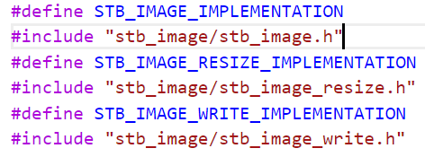
PART-1:
Lines 1:
define stb_image implementation this line help to define ST_IMAGE_IMPLEMENTATION which is used by the ‘stb_image.h’ header to include the actual implementation of the library functions
Line 2:
this line includes the stb_image.h header, which provides functions for loading image files (such as JPEG and PNG) into memory.

Slide 24
Line3:
This line defines the macro STB_IMAGE_RESIZE_IMPLEMENTATION, which is used by the stb_image_resize.h header to include the actual implementation of the library functions
Line 4:
#include "stb_image/stb_image_resize.h": This line includes the stb_image_resize.h header, which provides functions for resizing images in memory
Line 5:
#define STB_IMAGE_WRITE_IMPLEMENTATION: This line defines the macro STB_IMAGE_WRITE_IMPLEMENTATION, which is used by the stb_image_write.h header to include the actual implementation of the library functions.
Line 6:
#include "stb_image/stb_image_write.h": This line includes the stb_image_write.h header, which provides functions for writing image data to disk in various formats (such as PNG and JPG).

Slide 25
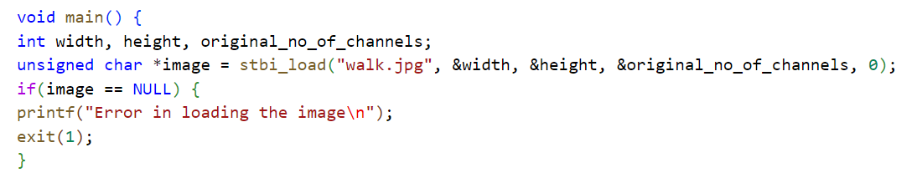
PART-2:
void main(): This line defines the main function, which is the entry point of the program.
int width, height, original_no_of_channels;: These three variables are used to store the dimensions of the loaded image and the number of channels (e.g. red, green, blue, and alpha) in the image data.
unsigned char *image = stbi_load("walk.jpg", &width, &height, &original_no_of_channels, 0);: This line uses the stbi_load function from the stb_image.h library to load the image data from the file "walk.jpg" into memory. The loaded data is stored in a dynamically-allocated buffer pointed to by the image variable. The dimensions of the image and the number of channels are stored in the width, height, and original_no_of_channels variables. The 0 argument tells the function to automatically determine the number of channels in the image.

Slide 26
if(image == NULL) {: This line checks if the image data could not be loaded, for example because the file does not exist or the file is in an unsupported format.
printf("Error in loading the image\n");: If the image data could not be loaded, this line prints an error message.
exit(1);: If the image data could not be loaded, this line terminates the program with a non-zero exit status to indicate an error.

Slide 27
PART-3:
printf("Loaded image with a width of %dpx, a height of %dpx and %d original_no_of_channels\n", width, height, original_no_of_channels) :This line prints a message indicating that the image was loaded successfully, and displays the width, height, and number of channels of the image.

Slide 28
Float scalefactor; This is a variable to store the scale factor for resizing the image.
printf("Enter the scale factor: ") : This line prompts the user to enter the scale factor.
scanf("%f",&scalefactor):This line reads the user's input and stores it in the scalefactor variable.

Slide 29
PART-4:
int new_width = width * scalefactor: This line calculates the new width of the resized image by multiplying the original width by the scale factor.
int new_height = height * scalefactor: This line calculates the new height of the resized image by multiplying the original height by the scale factor.

Slide 30
unsigned char *resized_img = malloc(new_width * new_height * original_no_of_channels): This line allocates memory for the resized image using the malloc function. The amount of memory allocated is calculated based on the new width, new height, and number of channels of the image

Slide 31
PART-5:
The line "stbir_resize_uint8(image, width, height, 0, resized_img, new_width, new_height, 0, original_no_of_channels);" resizes the image using the stbir_resize_uint8 function from the stb_image_resize library. The function takes the original image, its width, height, and number of channels, as well as the resized image, its width, height, and number of channels, and performs the resize operation.

Slide 32
PART-6:
The line "stbi_write_png("walk_resized.png", new_width, new_height, original_no_of_channels, resized_img, new_width * original_no_of_channels);" saves the resized image in PNG format using the stbi_write_png function from the stb_image_write library. The function takes the name of the output file, the width, height, and number.
The line "stbi_write_jpg("walk_resized.png", new_width, new_height, original_no_of_channels, resized_img, new_width * original_no_of_channels);" saves the resized image in jpgformat using the stbi_write_jpgfunction from the stb_image_write library. The function takes the name of the output file, the width, height, and number.

Slide 33
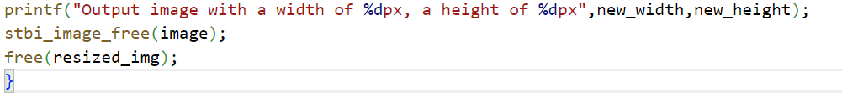
PART-7:
The format string "Output image with a width of %dpx, a height of %dpx" takes two integer arguments new_width and new_height and outputs a string indicating the dimensions of the resized image.
The function stbi_image_free(image) on line 61 is used to free the memory occupied by the original image, which was loaded using the function stbi_load() .
The function free(resized_img) is used to free the memory occupied by the resized image. The resized image was allocated memory using the malloc() function .

Slide 34

OUTPUT
INPUT IMAGE | OUTPUT IMAGE
Size :5236x 3491 | Size :7854x5236

Slide 35


OUTPUT
INPUT IMAGE | OUTPUT IMAGE
Size :1000x1503 | Size :800x1202

Slide 36
CONCLUSION:
Resizing an image can be useful in image processing tasks such as object detection, image recognition, and image segmentation because it allows the processing to be performed on a smaller image, reducing computational time and memory usage. Resizing images is frequently required for web development, as images that are too large can slow down website loading times and take up too much storage space. Resizing an image to a specific size is important for printing because printing an image that is too large or too small can result in a loss of detail or quality.

Slide 37
THANK YOU

